Slide 1
Guidelines
Text must be written in English.
Except for opening slide, only 10 slides are allowed.
Criteria | Maximum Points
Clear Presentation + Introduction | 10
Direct Question Answering | 10
Dataset Explanation | 7
Current Approach | 7
Improvements + Results | 18
Code Questions | 15
Algorithms (PCA, Wav2Vec2, etc..) | 18
Open Questions & Future Work | 15

Slide 2
Language Agnostic Gender Detection
Raz Gavrieli - 209380922
Daniel Zaken - 207296989
Hodaya Turgeman - 2114685252
Sivan cohen- 322716309
Stav Zilber -322809559
Amit Waizman -314635756
Moriah David- 206524266
Itamar Caspi - 315874982
Firas Naamneh - 211415385

Slide 3
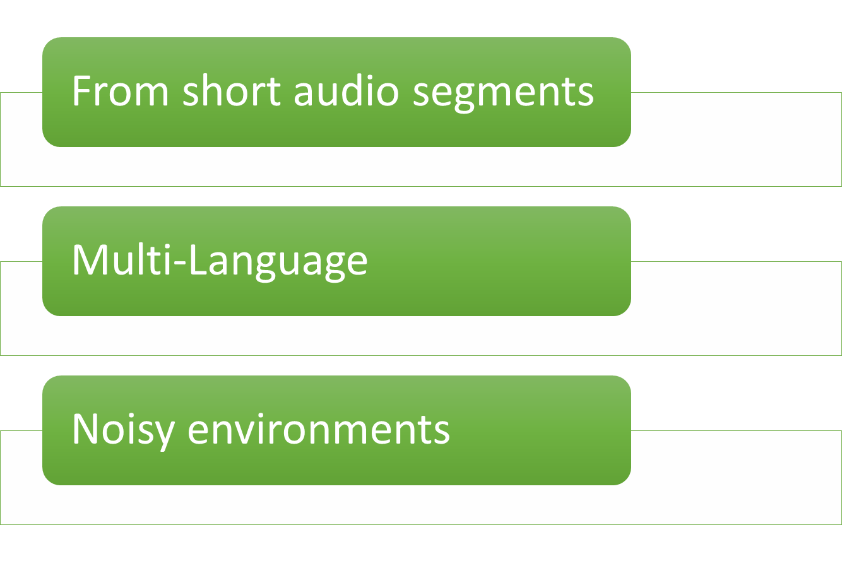
Introduction
problem & solution
Gender Detection:
Notes:
PROBLEMS:
Gender identification from short voice recordings and comparison between Wav2Vec2.0 emission transformer data and Spectrogram data.
Expanded the problem into investigating a usecase: gender identification in noisy environments (nightclubs, stadiums..)
Investigating language agnostic models
SOLUTIONS:
In our solutions, we have also investigated the difference in performance and accuracy between a CNN model that was trained on Wav2Vec 2.0 emission data and a CNN model that was trained on Spectrogram data of the same recordings.
We have created an augmented dataset by appending music to the background of voice recordings.
Trained the models on different permutations of languages to test language agnostic models.

Slide 4
Introduction
related work
Studies that contributed to the project through interesting techniques and tools.
Interesting studies dealing with the gender identification of the speaker
some language agnostic gender detection projects.
Notes:
רילייטד וורק

Slide 5
Dataset
Common voice
https://www.mdpi.com/1424-8220/21/17/5892
https://doi.org/10.1155/2022/4444388
Language | Male Clips | Female Clips | Average duration length
English | 787,886 | 270,199 | 5.097
Spanish | 190,986 | 83,950 | 5.087
French | 410,796 | 71,068 | 4.944
Russian | 90,285 | 24,045 | 5.112
Arabic | 17,807 | 14,836 | 4.082

Slide 6

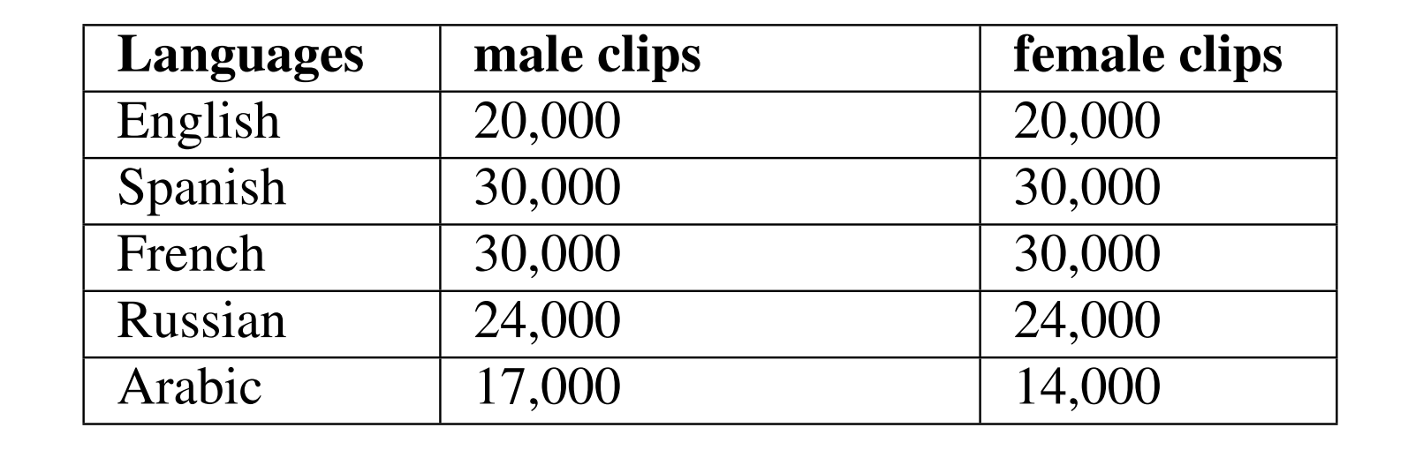
Gender bias
Notes:
תיאור הdataset ושינויים שעשינו עליו

Slide 7
Current Approach
To compare between Wav2Vec2.0 and Spectrogram, we have separated the preprocessing stage and created 2 datasets.
Wav2Vec2.0 is a model developed by facebook AI.
Spectrogram is a visual representation of frequencies.
To test language agnosticness, we created 4 permutations of 3 languages out of our 5 sample languages. We trained 4 models on those sets of languages and finally we trained a model on all 5.
To achieve our usecase - gender identification in a nightclub, we investigated into training the models on noisy recordings.
Overall, we trained and compared the results of over 18 different models to achieve our goals.
Notes:
השוואה בין wav2vec לspectrogram
השוואה בין קבוצות שונות של שפות לlangauge agnosticness
השוואה בין מודלים שאומנו על noisy וכאלה שרק על silent

Slide 8
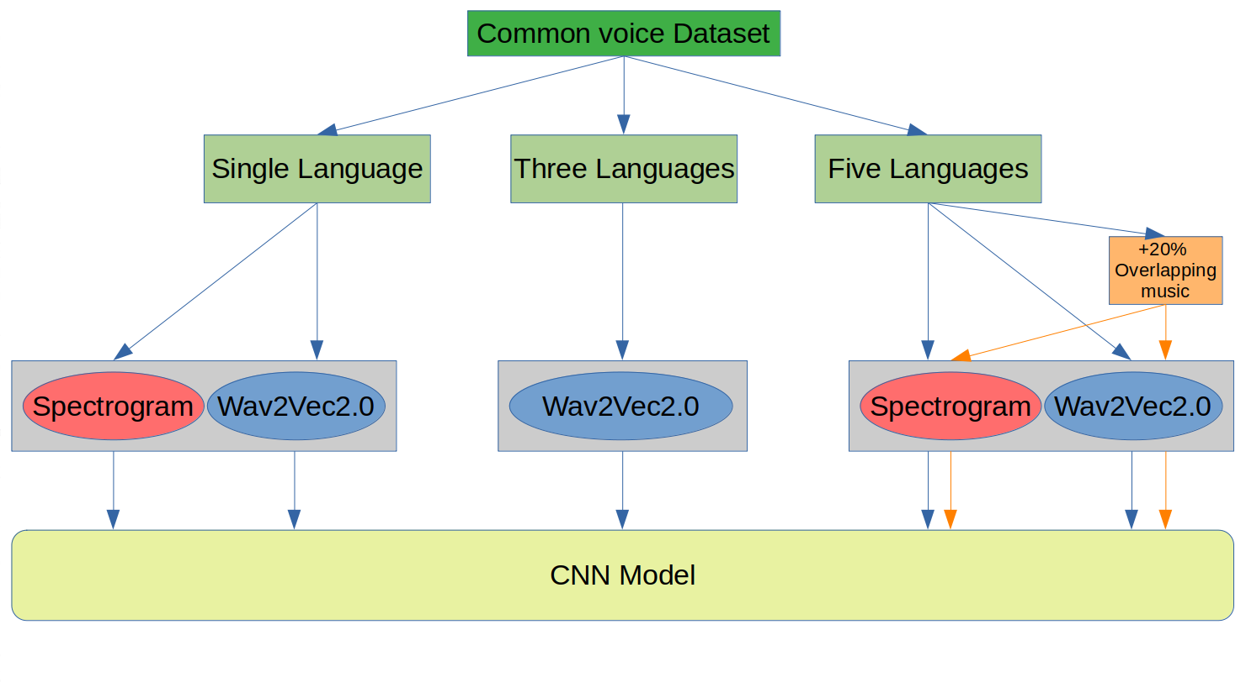
Current approach - new

Slide 9
Improvements - Accuracy
Our study focused on investigating the performance of different methods:
On the first experiment we compared two different preprocessing methods. We found out that the spectrogram data methods results in more accurate results.
The second experiment, dealt with language agnostic models. The results showed that the more agnostic models performed worse than their single-language counterparts.
On the third and final experiment, we trained models on both silent and noisy & silent datasets. We achieved better accuracy when testing noisy environment on a model that was designated to such task.
Notes:
שיפורים שעשינו לעומת מה?

Slide 10
Improvements - Performance
To improve runtime performance, we ran on CUDA work environment.
When using a spectrogram we witnessed slow performance, we had to shrink the data size by 2 (640x480 -> 320x240). Note that, we still achieved good model accuracy.
Overall, in all 3 experiments we have witnessed faster performance in preprocessing, testing and training with Wav2Vec2.0 emission transformer data.

Slide 11
Results
SPECTROGRAM VS WAV2VEC2
Single Language Results
 | Accuracy
Language | Wav2Vec2 | Spectrogram
Arabic | 89 | 97.22
Spanish | 80.24 | 97.08
English | 79.33 | 93.75
Russian | 89.86 | 99.24
French | 81.14 | 97.31
Multi-language Results
Noisy-Environment Results
 | Accuracy
Language | Wav2Vec2 | Spectrogram
E,S,F,A,R | 82.82 | 88.61
 | Accuracy
Environment | Wav2Vec2 | Spectrogram
Noisy & Silent | 81.19 | 98.79
Silent | 75.99 | 88.69

Slide 12
Results
Achieving Language Agnostiness
Language Permutations (Wav2Vec2.0)
 |  | Accuracy
Train | Test | Result
E; S; F | A; R | 77.4
E; S; A | F; R | 80.89
E; S; R | A; F | 77.7
S; R; A | E; F | 76.26
E; S; F; A; R | E; S; F; A; R | 82.82

Slide 13
Results
Nightclub scenario
 | Accuracy
Environment | Wav2Vec2 | Spectrogram
Noisy & Silent | 81.19 | 98.79
Silent | 75.99 | 88.69

Slide 14
Discussion – Algorithms
Wav2Vec 2.0
Wav2Vec2.0 uses a CNN as first step of the model on raw audio data, the next step is processing the output through a transformer layer.
A type of neural network proposed in “Attention is All You Need” by Vaswani et al in 2017.
One of the advantage of using Wav2Vec2.0 emission is that its output contains contextual understanding.
Model - LINK TO THE MODEL (GITHUB)
We used a CNN model with 6 layers of convolution and two layers that are fully connected with dropout. There is a max pooling layer with batch normalization between each layer. We used ReLU activation function, logSoftmax for the two classes.

Slide 15
Discussion – Open Questions & Future Work
In future work we can compare different languages and dialects to investigate gender identification between single language models (may require language experts). When attempting to achieve language agnosticness, we choose sets of 3 languages arbitrarily.
Fine tuning Wav2Vec’s model - there are many related works with fine tuning the Wav2Vec model. We might be able to change the preprocessing stage and try to improve our Wav2Vec accuracy performance without hitting runtime performance.
There were several previous studies that used the combination of the MFCC and the mel-spectrogram and reached high results, so another direction in the article is to examine the effect of the combination on the performance of the model

